Slide 1
Anomaly Detection Challenge -2 Satellite Image Data
“The Outliers” presents
Nithish Raghunandanan
Vishal Bhalla

Slide 2
Agenda
Introduction
Data Pre-processing
Rearrangement of the Data
Replacement of Missing Values
System Pipeline
Data Model
Evaluation of the Models
Results
Conclusion

Slide 3
Introduction
Aim: Classify the given the multi-spectral values in a satellite image.

Slide 4
Data Pre-processing
Rearrangement of the Data
Given data set had the Spectral Data combined together.
Grouped all the data pertaining to a Spectrum together.
Eg. SD1 SD1 SD1 SD1 SD2 SD2 SD2 SD2..
SD1 SD2 SD3 SD4..

Slide 5
Data Pre-processing (2)
Replacement of Missing Values
Zeros
Column Mean
Column Median
Row Mean
Row Median
Column Minimum
Column Maximum
Row Minimum
Row Maximum

Slide 6
Data Pre-processing(3)
Mid Value
Maximum Value
Minimum Value
Row Spectral Minimum
Row Spectral Maximum
Row Spectral Mean
Row Spectral Median
Row Mode
Column Mode
Interpolated Values

Slide 7
System Pipeline
Data Pre-processing
Model
Analysis of Results
We iteratively used the above pipeline to arrive at the best model

Slide 8
Model
We tried different types of Multi Class Classification Models to fit our data
One Versus One and One Versus Rest Multiclass Classification
Random Forests
Gaussian , Bernoulli and Multinomial Naïve Bayes Classifier
Multi Class SVM with Linear Kernel
K Nearest Neighbours

Slide 9
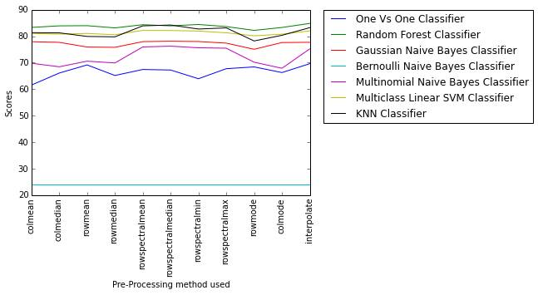
Evaluation of the Models
Criteria
Classification Accuracy on Stratified K-Fold Cross Validation with a split of 4:1.

Slide 10
Results
Model | Replacement Technique | Public Score (Classification Accuracy) | Private Score(Classification Accuracy)
Random Forest (50 trees with Entropy) | Row Spectral Median | 0.89800
Random Forest (50 trees with Gini) | Row Spectral Median | 0.89300
KNN with 3 neighbours | Row Spectral Median | 0.89200
Random Forest(Gini) | Interpolation | 0.89000
KNN with 3 neighbours | Row Spectral Median | 0.89000
KNN with 3 neighbours | Column Mean | 0.87800
Multi-class Linear SVM | Row Spectral Median | 0.84000

Slide 11
Conclusion
The best results were observed for Random Forest (50 trees with Entropy as a criterion) on rearranged data and using row spectral median values for missing values.
Regularization would help reduce the overfitting, but we couldn’t find the best penalty factor for any of our models.

Slide 12
Thank You !

